Slide 1
Remember me

Slide 2







OID
TECH
Not a member?
Remember me

Slide 3


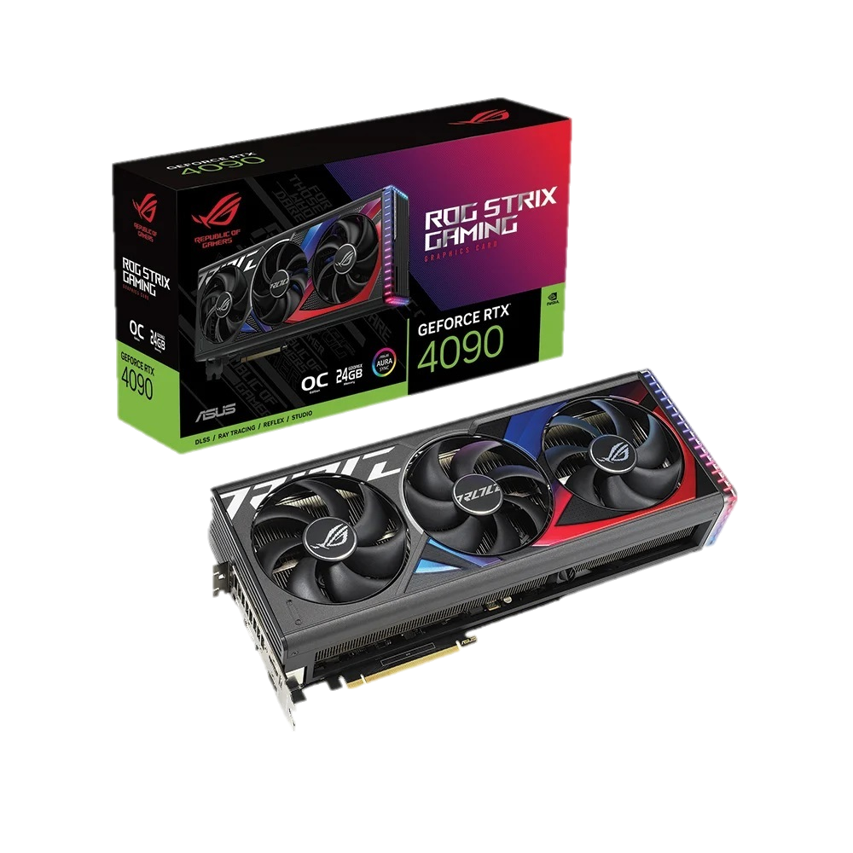
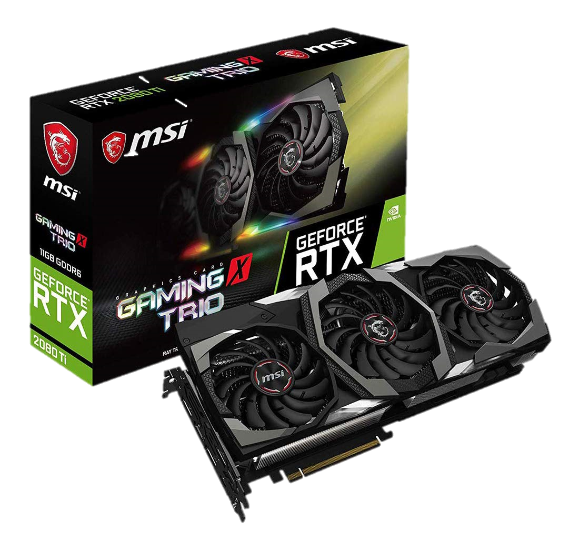
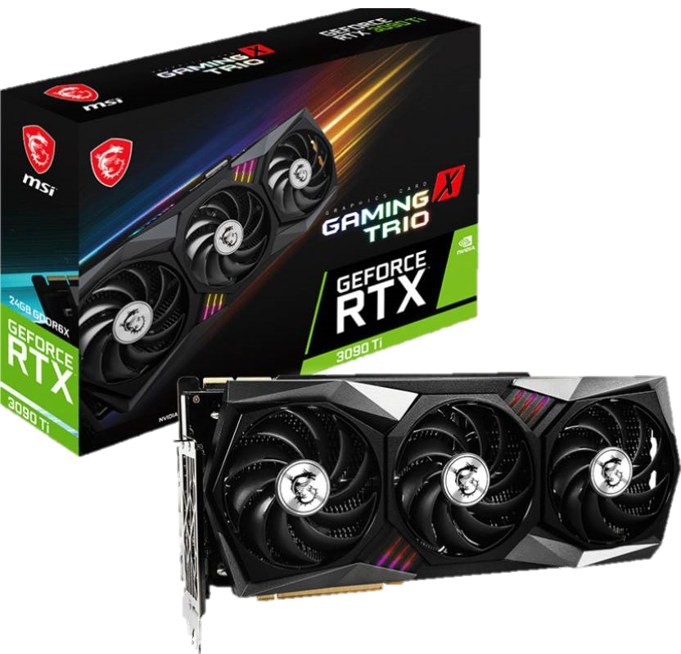

OID
TECH
PROFILE
CONTACT
RTX 4090
RTX 3090 Ti
RTX 2080 Ti
238,999 TK
198,000 TK
138,500 TK
VIEW DETAILS
VIEW DETAILS
VIEW DETAILS
Remember me

Slide 4

OID
TECH
RTX 4090
Key Features
MPN: ROG-STRIX-RTX4090-O24G-GAMING
Model: ROG Strix GeForce RTX 4090 OC Edition 24GB GDDR6X
NVIDIA Ada Lovelace Streaming Multiprocessors
4th Gen Tensor Cores, 3rd Gen RT Cores
Axial-tech fans, 3.5-slot design
Output: 3x DisplayPort 1.4a, 2x HDMI 2.1a
238999 TK
Buy Now
Remember me

Slide 5
OID
TECH
RTX 4090
Key Features
MPN: ROG-STRIX-RTX4090-O24G-GAMING
Model: ROG Strix GeForce RTX 4090 OC Edition 24GB GDDR6X
NVIDIA Ada Lovelace Streaming Multiprocessors
4th Gen Tensor Cores, 3rd Gen RT Cores
Axial-tech fans, 3.5-slot design
Output: 3x DisplayPort 1.4a, 2x HDMI 2.1a
238,999 TK
Remember me

Slide 6
OID
TECH
Address :
Quantity :
Shipping :
Total :
Balance :
New Balance :
ASUS ROG STRIX GEFORCE RTX 4090
Place Order
Remember me

Slide 7


OID
TECH
Order Placed
Order Summer :
ASUS ROG STRIX GEFORCE RTX 4090
Name :
Phone Number :
Email Address :
Total Amount :
Delivery Address :
Home
Print
Remember me

Slide 8
OID
TECH
RTX 3090 Ti
Key Features
Model: GeForce RTX 3090 Ti Gaming X Trio 24G
Boost Clock: 1920 MHz, Memory Speed: 21 Gbps
TRI FROZR 2 Thermal Design
RGB Mystic Light
DisplayPort x 3 (v1.4a), HDMI x 1
198,000 TK
Buy Now
Remember me

Slide 9
OID
TECH
Address :
Quantity :
Shipping :
Total :
Balance :
New Balance :
RTX 3090 Ti
Place Order
Remember me

Slide 10
OID
TECH
Order Placed
Order Summer :
GeForce RTX 3090 Ti Gaming X Trio 24G
Name :
Phone Number :
Email Address :
Total Amount :
Delivery Address :
Home
Print
Remember me

Slide 11
OID
TECH
RTX 2080 Ti
Key Features
Model: MSI GeForce RTX 2080 Ti Gaming X Trio
Memory 11GB GDDR6
Core Clocks Boost: 1620 MHz
NVIDIA G-SYNC and HDR
Interface PCI Express x16 3.0
138,500 TK
Buy Now
Remember me

Slide 12
OID
TECH
Address :
Quantity :
Shipping :
Total :
Balance :
New Balance :
RTX 2080 Ti
Place Order
Remember me

Slide 13
OID
TECH
Order Placed
Order Summer :
MSI GeForce RTX 2080 Ti Gaming X Trio
Name :
Phone Number :
Email Address :
Total Amount :
Delivery Address :
Home
Print
Remember me

Slide 14
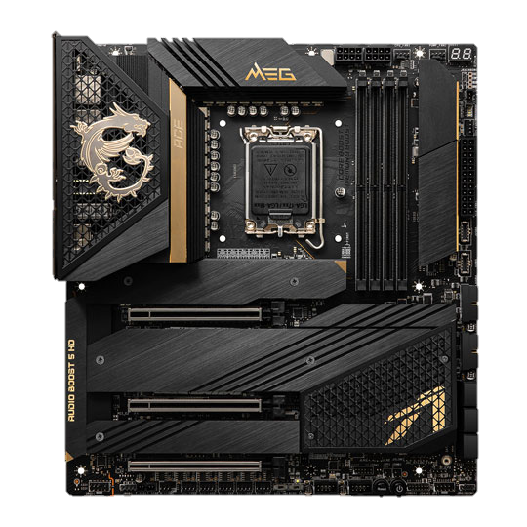
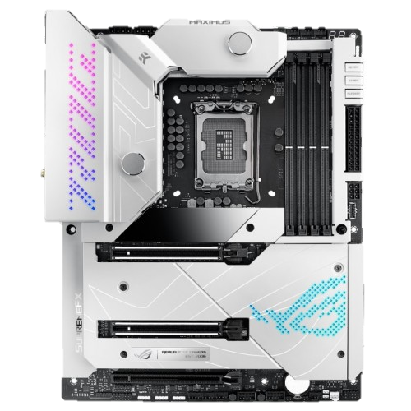
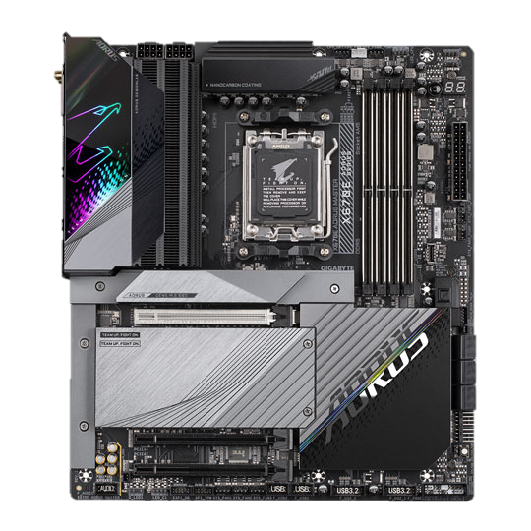
OID
TECH
PROFILE
CONTACT
MSI MEG Z690 ACE
ASUS ROG MAXIMUS Z690
X670E AORUS MASTER
78,400 TK
76,300 TK
52,500 TK
VIEW DETAILS
VIEW DETAILS
VIEW DETAILS
Remember me

Slide 15
OID
TECH
MSI MEG Z690 ACE
Key Features
Model: MEG Z690 ACE
Supported Processor: 12th Gen Intel Core / Pentium Celeron
Supported Socket: LGA 1700 socket
Onboard 5x M.2 connectors
Dual 2.5G LAN with latest Wi-Fi 6E
78,400 TK
Buy Now
Remember me

Slide 16
OID
TECH
Address :
Quantity :
Shipping :
Total :
Balance :
New Balance :
MSI MEG Z690 ACE
Place Order
Remember me

Slide 17
OID
TECH
Order Placed
Order Summer :
MSI MEG Z690 ACE
Name :
Phone Number :
Email Address :
Total Amount :
Delivery Address :
Home
Print
Remember me

Slide 18
OID
TECH
ASUS ROG MAXIMUS Z690
Key Features
Model: ROG MAXIMUS Z690 FORMULA
LGA 1700 for 12th Gen Intel Core, Pentium Gold, and Celeron processors
20+1 teamed power stages rated for105 A
Onboard WiFi 6E, Marvell AQtion 10 Gb Ethernet
PCIe 5.0, dual Gen 4 M.2 onboard
76,300 TK
Buy Now
Remember me

Slide 19
OID
TECH
Address :
Quantity :
Shipping :
Total :
Balance :
New Balance :
ASUS ROG MAXIMUS Z690
Place Order
Remember me

Slide 20
OID
TECH
Order Placed
Order Summer :
ASUS ROG MAXIMUS Z690
Name :
Phone Number :
Email Address :
Total Amount :
Delivery Address :
Home
Print
Remember me

Slide 21
OID
TECH
X670E AORUS MASTER
Key Features
Model: X670E AORUS MASTER
Supported CPU: Ryzen 7000 Series Processors for Socket AM5
Supported RAM: 4x DDR5, Max 128GB
Graphics Output: 1 x DisplayPort, 1 x USB Type-C, 1 x HDMI
Features: Intel 2.5GbE LAN & Intel Wi-Fi 6E 802.11ax
52,500 TK
Buy Now
Remember me

Slide 22
OID
TECH
Address :
Quantity :
Shipping :
Total :
Balance :
New Balance :
X670E AORUS MASTER
Place Order
Remember me

Slide 23
OID
TECH
Order Placed
Order Summer :
X670E AORUS MASTER
Name :
Phone Number :
Email Address :
Total Amount :
Delivery Address :
Home
Print
Remember me

Slide 24
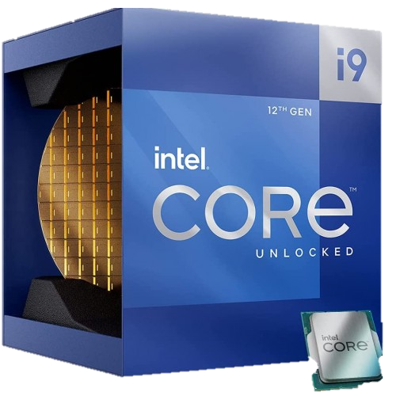
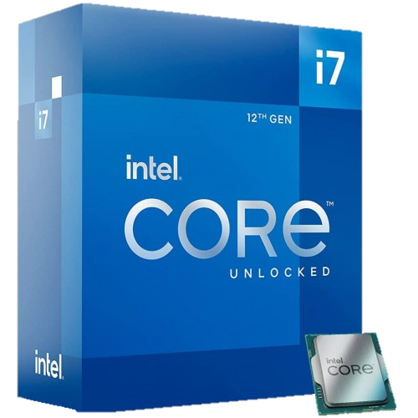
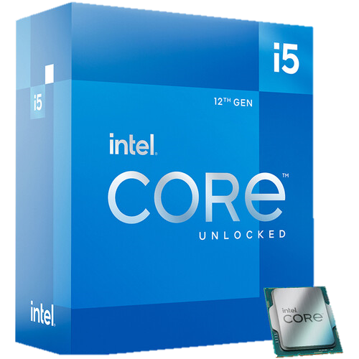
OID
TECH
PROFILE
CONTACT
INTEL CORE i9-12900K
INTEL CORE i7-12700K
INTEL CORE i5-12600K
69,000 TK
47,000 TK
34,200 TK
VIEW DETAILS
VIEW DETAILS
VIEW DETAILS
Remember me

Slide 25
OID
TECH
INTEL CORE i9-12900K
Key Features
Model: Core i9-12900K
Clock Speed: 3.70 GHz Up to 5.20 GHz
Cache: 30 MB, Socket: LGA 1700
CPU Cores: 16, CPU Threads: 24
GPU name: Intel UHD Graphics 770
69,000 TK
Buy Now
Remember me

Slide 26
OID
TECH
Address :
Quantity :
Shipping :
Total :
Balance :
New Balance :
INTEL CORE i9-12900K
Place Order
Remember me

Slide 27
OID
TECH
Order Placed
Order Summer :
INTEL CORE i9-12900K
Name :
Phone Number :
Email Address :
Total Amount :
Delivery Address :
Home
Print
Remember me

Slide 28
OID
TECH
INTEL CORE i7-12700K
Key Features
Model: Core i7-12700K
Clock Speed: 3.60 GHz Up to 5.0 GHz
Cores: 12, Threads: 20
Cache: 25 MB Intel Smart Cache
Socket: LGA 1700
47,000 TK
Buy Now
Remember me

Slide 29
OID
TECH
Address :
Quantity :
Shipping :
Total :
Balance :
New Balance :
INTEL CORE i7-12700K
Place Order
Remember me

Slide 30
OID
TECH
Order Placed
Order Summer :
INTEL CORE i7-12700K
Name :
Phone Number :
Email Address :
Total Amount :
Delivery Address :
Home
Print
Remember me

Slide 31
OID
TECH
INTEL CORE i5-12600K
Key Features
Model: Core i5-12600K
Base Clock: P-Core: 3.7 GHz, E-Core: 2.8 GHz
Max. Boost: P-Core: 4.9 GHz, E-Core: 3.6 GHz
Cache: 20MB, Socket: LGA 1700
CPU Cores: 10, CPU Threads: 16
34,200 TK
Buy Now
Remember me

Slide 32
OID
TECH
Address :
Quantity :
Shipping :
Total :
Balance :
New Balance :
INTEL CORE i5-12600K
Place Order
Remember me

Slide 33
OID
TECH
Order Placed
Order Summer :
INTEL CORE i5-12600K
Name :
Phone Number :
Email Address :
Total Amount :
Delivery Address :
Home
Print
Remember me

Slide 34

OID
TECH
Account creation
Create Account
Already have an account?
Remember me
If you already have an account with us, please login at the

Slide 35



OID
TECH
PROFILE
CONTACT
GRAPHICS CARD
PROCESSOR
MOTHERBOARD
Remember me

Slide 36


OID
TECH
Logout
Username :
Phone :
Email :
Balance :
Recharge Balance
Remember me

Slide 37
OID
TECH
Order Placed
Print
Remember me

